Slide 1



Roadmap to Recovery
An Industry Recovery Plan for the UK Construction Sector
Construction Leadership Council
Retention Payments in the Construction Industry Consultation
Notes:
Main slide

Slide 2
Executive Summary
Executive Summary
Roadmap to Recovery is a strategy to drive the recovery of the construction and built environment sectors, and through them the wider UK economy, following the Covid19 pandemic and economic downturn.
Construction is uniquely placed to drive the national economic recovery. It operates throughout the UK, employs over 3m workers, and exports billions of pounds of products and services.
The strategy aims to increase the level of activity across the construction ecosystem, accelerate the process of industry adjustment to the new normal, and build capacity in the industry to deliver strategic priorities, including: increasing prosperity across the UK; decarbonisation; modernisation through digital and manufacturing technologies; and delivering better, safer buildings.
There are 3 phases to the plan, to be delivered over two years:
  Restart: increase output, maximise employment and minimise disruption (0-3 months);
  Reset: drive demand, increase productivity, strengthen capability in the supply chain (3-12 months); and
  Reinvent: transform the industry, deliver better value, collaboration and partnership (12-24 months).
The outcomes will be a more capable, professional, productive and profitable sector, which delivers better value to clients, better performing infrastructure and buildings, and competes successfully in global markets.
Failure to act will miss an opportunity to deliver this, and risks the industry lapsing into a longer term recession, which erodes capability and skills, and leaves a smaller, weaker sector as a legacy.
Retention Payments in the Construction Industry Consultation
Notes:
Main slide

Slide 3
Outcomes and Benefits
Valuable investment outcomes including essential social and economic infrastructure, driving long-term productivity improvement across the economy, and supporting the delivery of public services. Delivering the national strategic infrastructure priorities identified by the National Infrastructure Commission, and a better co-ordinated approach to the planning and delivery of infrastructure and other built assets.
Reducing carbon emissions and improving the sustainability and resource efficiency of the construction and built environment sectors, and making measurable progress towards delivering net zero carbon.
Meeting societal needs, including more and better residential accommodation and safer buildings.
Direct contribution to regional economic recovery and prosperity, through high multiplier investments, relatively high earnings, fast cashflow and local supply-chains.
Transforming the business model of the sector to create a more collaborative, fairer and resilient industry, supporting firms in the supply chain to succeed and maintain the workforce at all levels.
Create an innovation culture that delivers efficient products, processes and built assets, to improve productivity, quality and increase output, including through embedding digital and offsite manufacturing technologies.
Increased investment in skills and training, at professional level, through vocational education and apprenticeships, and improving occupational health and safety for the workforce.
Building on UK strengths in digital design and systems, manufacturing and materials to increase UK exports of products and professional services, targeting a global infrastructure market worth US $2.5 trillion pa.
Retention Payments in the Construction Industry Consultation
Notes:
Main slide

Slide 4
Embedding CLC Objectives in the Recovery Plan
Digital, Manufacturing, Life Cycle Performance – driving a 33% reduction in lifetime costs and a 50% reduction in delivery times through improving productivity, to deliver better outcomes over the lifecycle of built assets for clients, and increase the profitability and sustainability of firms in the industry.
Delivering Industry Priorities
  Procure for Better Value – focusing procurement based on whole life value, not lowest cost.
  Skills – increasing skills levels and helping the industry adapt to change, building a more professional industry, embedding high standards of site safety, and improving occupational and mental health.
  Building Safety – ensuring remediation work can continue, and ensure the sector is reformed to create a legacy of safe building.
  Net Zero Carbon – improving design, product selection and manufacturing and construction processes to deliver built assets that achieve a 50% reduction in greenhouse gases as part of the pathway towards net zero.
  Innovation – delivering innovations, encouraging adoption at scale and measuring the benefits
  Fair Practices – fairer contractual and payment practices throughout the supply chain
Retention Payments in the Construction Industry Consultation
Notes:
Main slide

Slide 5
Industry Overview
Construction Sector Overview
Economic Output: £413 billion (2018), 8.6% of GDP. This is nearly 4x the combined annual output of the aerospace and automotive industries (£107 billion in 2018). GVA: £149 billion (2018). Employment: 3.1m, including contracting (2.3m), associated manufacturing and professional services). Structure: 405,000 firms, 900,000 sole traders, 300 large contractors, 41% of workforce (c943,000) self-employed.
Market: In 2018, the largest private sector markets were: private housing (£37.6 billion), new commercial construction (£31.2 billion), infrastructure e.g. utilities (£10.9 billion) and private industrial (£5.5 billion). Major public sector markets were: infrastructure (£11.4 billion); other public investment e.g. schools, hospitals (£10.5 billion) and public housing (£5.8 billion).
Regional Distribution (2018): London (53,600 firms, 188,000 employees); South East (55,100 firms, 197,400 employees); East of England (41,800 firms, 173,300 employees); South West (31,200 firms, 111,000 employees); North West (30,900 firms, 160,100 employees); West Midlands (24,800 firms, 103,900 employees); Yorkshire & the Humber (23,100 firms, 105,000 employees); East Midlands (22,600 firms, 85,300 employees); and North East (9,100 firms, 43,900 employees).
Planned investment includes: 700 projects and over £500 billion of investment in the National Infrastructure Pipeline (£118 billion in the Construction Pipeline). Planned investment also includes Government spend of £7.2 billion in housing.
Retention Payments in the Construction Industry Consultation
Notes:
Main slide

Slide 6
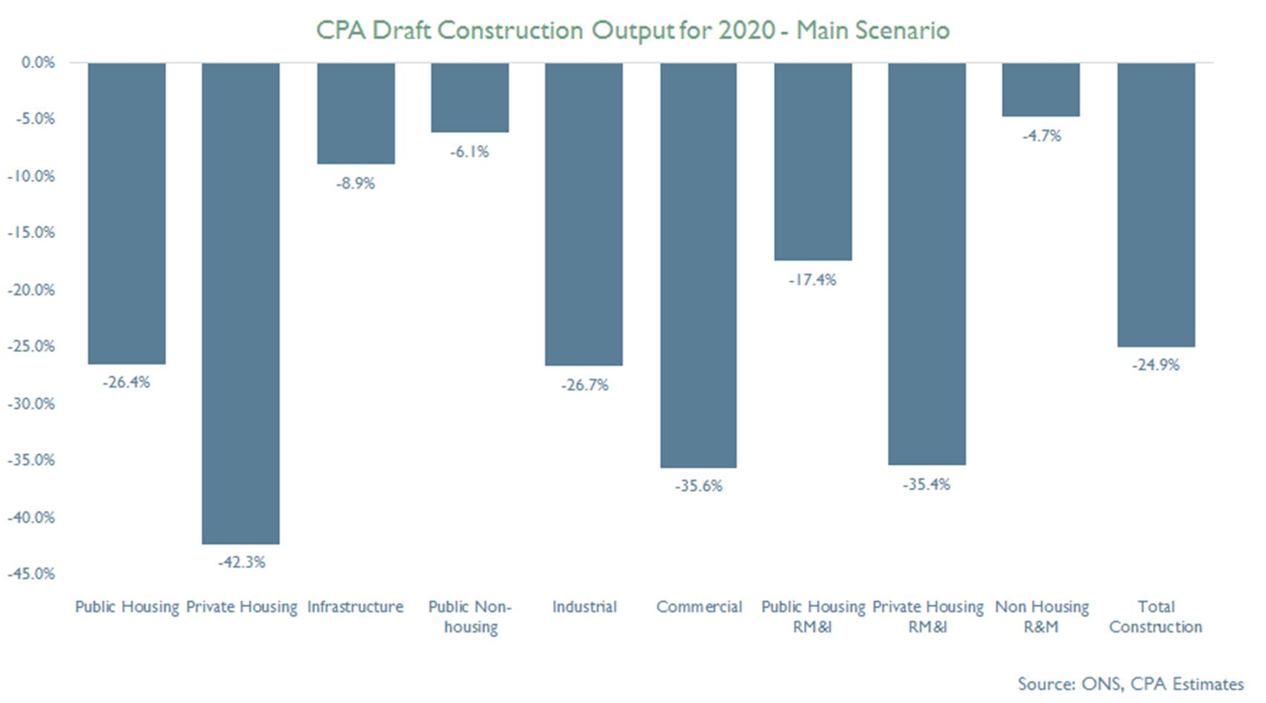
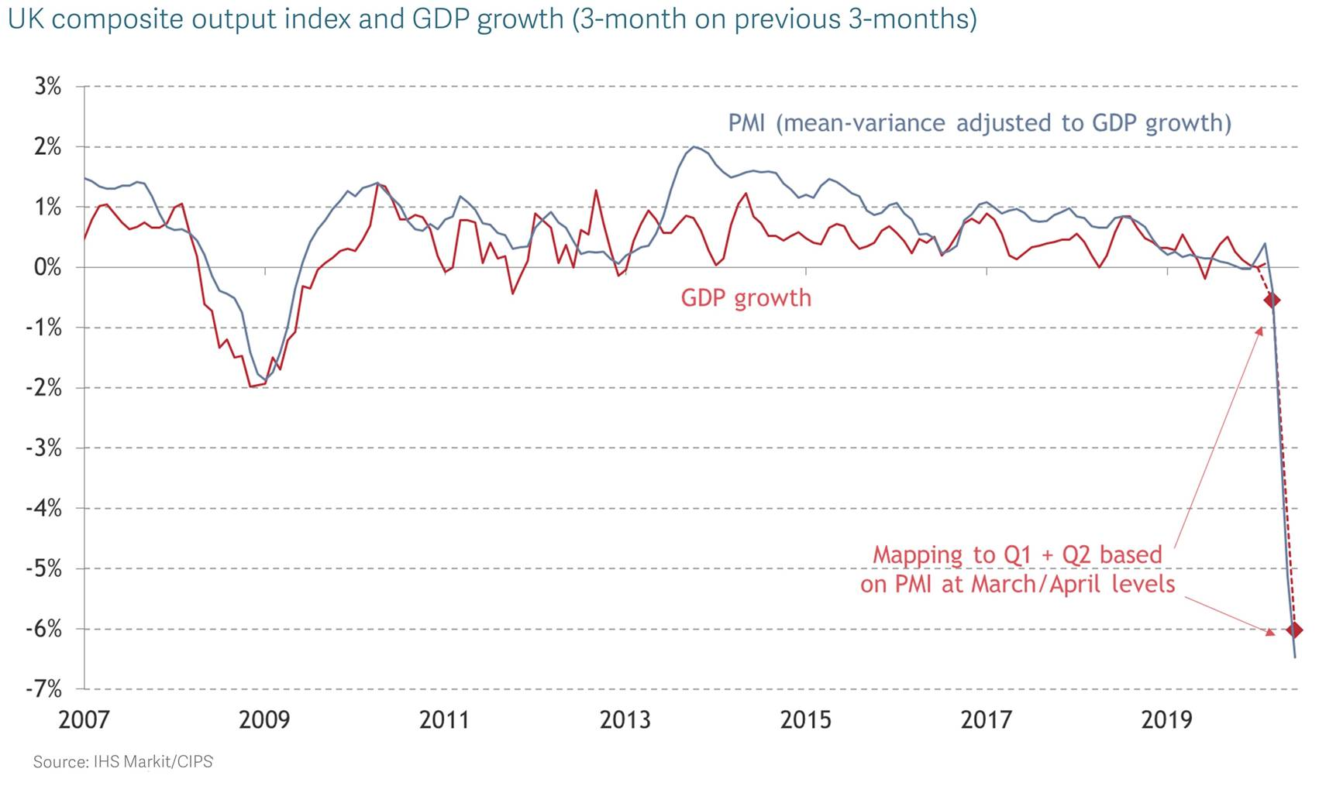
Impact of Covid19 on UK Construction
The Office of National Statistics reported construction activity fell by 2.6% in Q1 2020, and by 5.9% in March.
IHS Markit/CIPS UK Construction PMI registered 8.2 in April, compared with 39.3 in March.
Constructionline reported that of a survey of 4,500 firms in April, 47% had reduced their activity by 80% or more.
The Construction Products Association estimates that construction output will fall by 25% in 2020, with the largest falls in activity in private housing (-42%), commercial construction (-36%), and private repair maintenance & improvement (-35%).
The Federation of Master Builders reported 68% of builders had stopped 91% of projects in April.
The Builder’s Merchants Federation reported a decline of 6.7% in sales between Q4 2019, and Q1 2020. Timber and joinery products declined by 11.1%, and plumbing, heating and electrical products by 7.4%.
Retention Payments in the Construction Industry Consultation
Notes:
Main slide

Slide 7
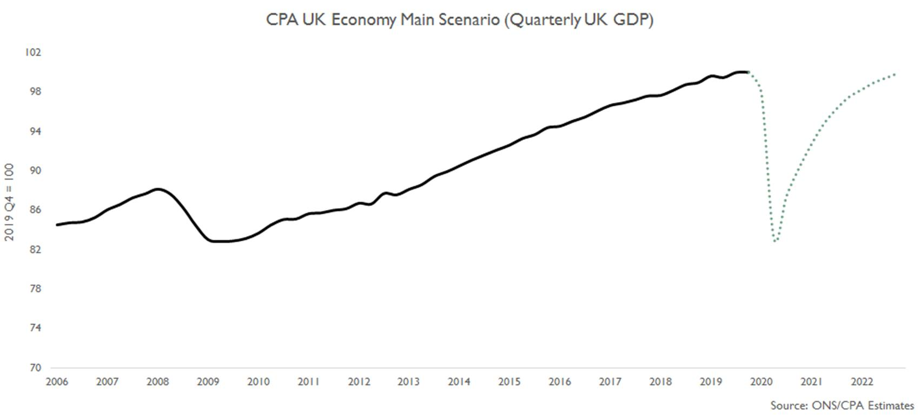
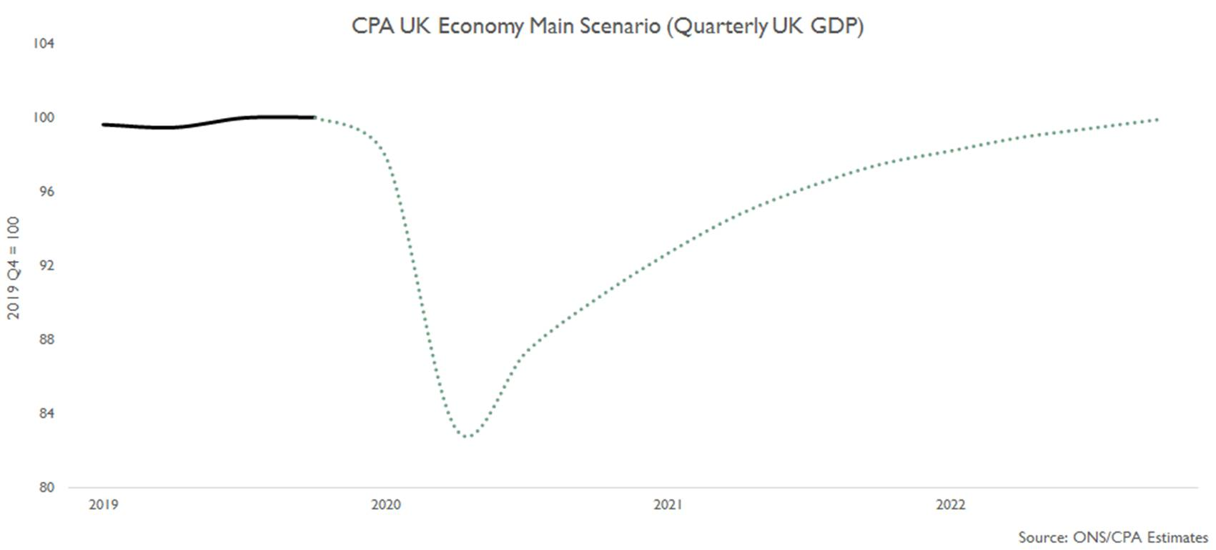
Construction Sector Recovery from Covid19
Anticipated that recovery from Covid19 will be gradual – lost output will require c2 years to recover, with most of the recovery in 2021.
The construction and built environment sector is an ecosystem – site activity may be different, but relies on a common supply chain of merchants and manufacturers to deliver, and these rely on demand from contractors, specialists, house builders and domestic RMI.
The industry also relies on related professions – architecture, engineering and consultancy to develop projects, gain approvals, and monitor and measure performance.
Costs and delivery time are likely to increase as a result of lost productivity from implementing social distancing. This will erode low margins further, and place additional cost pressure on firms, making it harder to invest for the future.
Supporting the recovery requires a single industry plan to co-ordinate activity to reactivate the whole ecosystem.
Retention Payments in the Construction Industry Consultation
Notes:
Main slide

Slide 8
Covid19 Challenges for Construction and the Built Environment
Convening & co-ordinating activity across a large sector with many individual firms, to minimise supply chain disruption or interruptions to production domestically or internationally.
Timescales for each sector of the industry will be different – and are influenced by client/consumer behaviour.
The construction and built environment sector is an ecosystem, and requires a critical mass of activity to restart – this is likely to require supply and demand side interventions to sustain.
Sector needs to work together – focus on what it needed to deliver critical mass across key sectors: 1) infrastructure; 2) construction; 3) housing; and 4) RMI.
Response needs to be agile, initiated quickly, then developed. Actions in each section of the Plan should be undertaken as soon as feasible, so that they can be implemented, rather than waiting for the conclusion of each phase. Actions are phased for purposes of prioritisation.
Retention Payments in the Construction Industry Consultation
Notes:
Main slide

Slide 9
Construction Industry Task Force: Outputs
Site/Branch Operating Procedures – advice to firms as to how to apply Government guidance on sites and in merchant branches for small firms and mineral product producers, together with videos/case studies and training materials for firms, and advice on temporary site suspension.
Employment Schemes – advice to firms on the Job Retention Scheme (JRS), and for self-employed workers on the Self-Employment Income Support Scheme (SEISS). Developed proposals for future design of the JRS to support firms moving workers back into employment.
Cost Planning – work to quantify the impact on costs, schedules and future output of Covid19 and mitigating measures.
Insurance and Bonds – work on the availability of trade credit insurance, professional indemnity insurance (PII) and bonds, to enable the industry to make best use of Government support and access the insurance products required to support activity.
Product Availability – gathering information about product availability and supply, the extent to which merchants are operating, and the level of demand for products.
Loan Finance – reviewing the operation of the CBILS/CLBILS in relation to the construction sector, and making recommendations as to how the industry and banks can ensure funding is available.
Guidance on Contractual Terms – CLC guidance on avoiding disputes, and supporting mechanisms for avoiding conflict and resolving disputes swiftly and effectively.
Showcasing the role of construction in responding to Covid19 – demonstrating the contribution the industry is making to essential services, and operating responsibly.
Retention Payments in the Construction Industry Consultation
Notes:
Main slide

Slide 10
Structure of the Recovery Plan
CLC Recovery Plan
Sectoral Recovery Plans
Restart
Clients
Mineral Product Suppliers
Manufacturers
Merchants
Professions
Consultants
Contractors & Specialists
CLC to set an overarching
co-ordinated industry strategy
Reset
Economic
Infra-structure
Housing
Reinvent
Domestic RMI
Local, Social & Commercial Construction
Industry bodies and partners develop sub-sector specific plans that align with CLC’s overarching Recovery Plan. Each specific plan would highlight the actions and economic benefits being proposed, and align methodologies to the finance requirements for investors.
BEIS - PMO
Retention Payments in the Construction Industry Consultation
Notes:
Main slide

Slide 11
Industry Recovery Plan
Phase | What
Restart (1-3 months) | 1. Restart work on all projects and programmes, and increase this to the highest level possible consistent with Government guidance
 | 2. Maximise employment of all those working in the construction industry and supply chain
 | 3. Minimise disruption due to contractual disputes.
Reset (3-12 months) | 1. Demand and Pipeline - economic stimulus measures to increase workload across infrastructure, construction, housing and domestic new build and RMI, and develop a robust pipeline of work across the whole construction ecosystem, including contracting, SMEs, merchants and manufacturers.
 | 2. Productivity – new approaches will be needed to compensate for the loss of productivity due to the requirement to implement Government guidelines across construction and the built environment
 | 3. Professionalism – investing in training, collaborative business models, fairer contracts and payment
Reinvent (12+ months) | 1. Transformation – sustain economic growth through the adoption of digital and manufacturing technologies to consistently deliver low carbon, sustainable and better quality outputs and outcomes
 | 2. Value – adopting procurement models and approaches across the industry and clients to deliver better value and whole life performance
 | 3. Partnership – stronger partnerships between the industry and its clients, supply chain firms, investment in upskilling the workforce
Retention Payments in the Construction Industry Consultation
Notes:
Main slide

Slide 12
Restart 1 : Restart work on all projects and programmes, and increase this to the highest level possible consistent with Government guidance.
Restarting work on the broadest basis (infrastructure, commercial, house building, RMI) from major contractors, to thousands of SMEs across all regions of the UK, and to skilled tradespeople, is the best means of reactivating the ecosystem and ensuring cash flows within the industry. Ensure work across the construction ecosystem can take place in accordance with Government guidance on Covid19 and H&S regulations and guidance.
Actions and Owners Provide and promote effective guidance on the safe operation of construction sites and for tradespeople working in homes, as well as for merchants and suppliers and ancillary functions such as site sales offices, and develop and roll out training for workers on implementing safe procedures for working on construction sites (HMG/Industry/CITB). Provide test, track and trace services for the construction workforce (HMG/Industry). Confirm timescales for public sector near to market schemes across housing and infrastructure (Q3/4 2020). Public sector clients to expedite design and planning phases of projects in their pipeline, and monitor the progress of these (All public sector clients). Private sector clients to confirm their anticipated level of investment over the life of the Plan (Private Sector Clients). Share information about material and product supply and demand across construction firms, materials and product producers and merchants (CLC Task Force/BEIS). Extend working hours on sites where reasonable to do so (HMG/local authorities). Extend planning expiry dates and explore other flexibilities, so permissions are not lost due to Covid19 disruption, and ensure the planning system continues to operate and facilitate development (HMG/local authorities).
Outcomes & Benefits
Reactivating the construction ecosystem will stimulate economic activity and employment across the UK and benefit other sectors.
Developing a pipeline of projects will give industry the confidence activity can be sustained.
Retention Payments in the Construction Industry Consultation
Notes:
Main slide

Slide 13
Restart 2: Maximise employment of all those working within the construction industry and its supply chain.
There are 2.3m workers in construction contracting, who are relatively well remunerated, and labour costs are a very high proportion of the industry cost base – cash flowing into construction will help restart the wider economy, and maintain skilled jobs throughout the UK, as well as ensuring the next generation of apprentices continue to be trained.
Actions and Owners Industry to move workers off JRS as soon as possible, and to restart the training of apprentices (CITB/Industry). Explore the introduction of a Talent Retention Scheme for workers in the construction sector and related professions, to match individuals at risk of employment with roles in other firms (Industry/HMG). Implement CITB Industry Stabilisation Plan to reduce cash flow pressures, including suspending Construction Levy payments and accelerating the award of grant funding (CITB/HMG). Develop distance learning tools to support apprentices and other learners to continue their learning until workplace training can resume (CITB). Building on the Government’s announcement (11/5), develop a more flexible Job Retention Scheme to enable support to continue to be provided during a phased return to work from July-Dec 2020 (HMG/Industry).
Outcomes & Benefits
Reduced cash flow pressures on firms, increased industry employment and retention of workers.
Minimising disruption to the delivery of apprenticeships and training.
Retention Payments in the Construction Industry Consultation
Notes:
Main slide

Slide 14
Restart 3 : Minimise disruption due to contractual disputes.
Disputes will damage the industry, cost money, and fracture supply chains – it is essential to minimise this disruption to get the industry back to work.
Actions and Owners Public sector clients to support contractors to restart and enhance the level of site activity, including through use of relief measures provided for by PPN02/20 to ease cash flow pressures and support supply chains, and to consider allowing extensions of time or increased budgets where necessary to cover unavoidable delays and cost increases where appropriate (All public sector clients). Industry commitment to ensure prompt payment to firms within the supply chain (Industry). Undertake work on cost planning in relation to the impact of Covid19 on construction and supply chain operations and output to date, the likely impact of social distancing and other restrictions in the future, and share this across the public and private sectors (CLC Task Force). Public and private sector clients commit to following Government and CLC guidance on responsible contractual behaviour, and consider adoption of the Conflict Avoidance Pledge to avoid disputes, and to seek adjudication through the most cost effective process (Industry/Public Sector).
Outcomes & Benefits
Avoiding disputes will help ensure supply chains continue to function effectively, and enable the industry and its clients to work collaboratively to minimise the output lost due to coronavirus.
Retention Payments in the Construction Industry Consultation
Notes:
Main slide

Slide 15

Reset 1: Demand and Pipeline – demand and supply-side measures to increase workload across infrastructure, construction, housing and domestic new build and RMI. Develop a robust pipeline of work across the whole construction ecosystem, including contracting, SMEs, merchants and manufacturers.
Measures to stimulate demand and create a robust pipeline across infrastructure, construction, homes and RMI will give the industry confidence to invest in skills and future capacity – stronger firms will drive growth and prosperity. This should include road, rail, flood defences, utilities, education, healthcare, housing (new build and maintenance), justice, security and defence. Demand interventions are needed to support firms across the industry, including large contractors and their supply chain, independent SMEs, house builders, merchants and manufacturers. The industry needs to be viewed as an ecosystem, where demand from all subsectors supports robust supply chains. The industry will also need support to maintain cashflow during the reset phase and beyond, through a clear pipeline of work and fiscal measures.
Actions and Owners Delay implementation of Reverse Charge VAT for 12 months to 1 Oct 2021 (HMG). Project Pipeline – Public bodies to publish revised pipelines of infrastructure projects, and Government to accelerate the development of business cases and outline designs for social and economic infrastructure, and to expedite procurement and construction of viable projects. Business cases and procurements need to take account of constraints and costs created by Government guidance (HMG). Support home purchasers through the Help to Buy scheme, through extending the physical completion date for purchases that qualify for support under the existing scheme from 31 December 2020. Building Safety – acceleration of the existing ACM cladding remediation programme and new £1bn non-ACM Building Safety Fund to provide a pipeline of early work that will help support the sector (HMG). Guarantees - Government to commit the remaining £4bn and consider adding further commitments to the 2017 housing guarantees programme, to support social housing, build-to-rent and SME housing delivery. (HMG/Homes England). Regeneration - supporting towns, homes and employment to level up the UK, and invest in developing the infrastructure chapters of local growth plans (HMG/LEPS/local authorities/industry).
Outcomes & Benefits
Higher levels of industry investment in capacity and capability, including investment in training. Reduced cash-flow pressure reduces the risk of insolvency and avoids unsustainable levels of debt. Ensuring investments contribute to net zero, resource efficiency and shared prosperity.
Retention Payments in the Construction Industry Consultation
Notes:
Main slide

Slide 16
Reset 2: New approaches will be needed to compensate for the loss of productivity due to the requirement to implement Government guidelines across construction and the built environment
New approaches will be needed to compensate for the loss of productivity due to restrictions – there are innovations available through the Transforming Construction Programme that can improve productivity and help ensure safe working and building safety. New approaches will need to be consistent with long term strategic objectives, including net zero carbon.
Actions and Owners Commitment to embed emerging innovations from the UKRI Transforming Construction Challenge and Construction Innovation Hub in the delivery of projects and firm operations (Industry/HMG). Implement Transforming Construction Challenge Recovery Plan and Delivery Accelerator to support projects within the Transforming Construction Challenge and accelerate the adoption of innovations across the sector (UKRI/CIH). Digital – embed the wider adoption of digital technologies across clients and throughout the supply chain, to enable better data and information sharing across the built environment to improve efficiency, productivity, sustainability and building safety (HMG/Industry).
Outcomes & Benefits
Integrating new technologies into projects and programmes will minimise output loss and contribute to improved industry productivity in the longer term, and deliver high quality, zero carbon and sustainable outputs.
Retention Payments in the Construction Industry Consultation
Notes:
Main slide

Slide 17
Reset 3: Professionalism – investing in training, collaborative business models, fairer contracts and payment terms and processes.
The industry needs to maintain investment in training and retraining workers to support this and the adoption of new technologies. Embed a better, fairer and more collaborative business model, with improved contractual and payment practices to respond to Covid19.
Actions and Owners Consider flexibility around Apprenticeship Levy contributions, due to the disruption caused by Covid19, and deliver the Budget commitment to ensure sufficient levels of apprenticeship funding are available to increase the number of high quality apprenticeships in SMEs and consider how to improve the working of the Apprenticeship Levy to better support the industry’s skills needs (HMT/DfE). Ensure apprentices and learners in the sector are able to continue their training, including through wider adoption of new apprenticeship models and other forms of training, as well as Construction Skills Fund/onsite training models, to ensure that this is continued, and apprenticeships are not lost due to firm closure or redundancy (DfE/CITB/Industry). Improve the links between the FE sector and employers and strengthen the pathways from FE into apprenticeships and employment within the industry to avoid the loss of potential employees (CITB/Industry). Develop a programme to bring former construction workers, those with transferrable skills and young people at risk of unemployment into the industry, using Go Construct as the industry’s careers website (CITB/Industry). Building Safety - work with the industry to develop proposals for raising competence levels, including the development of an overarching competency framework for industry (Industry/HMG). New ways of working to embed better and more collaborative business models and contractual terms to respond to Covid19 (HMG/Industry). Strengthen support for direct employment as an enabler of apprenticeships, digital upskilling and competence (HMG/Industry). Improve and embed higher standards of safety practices within the industry, including occupational and mental health and safety (CLC, HSE, CONIAC).
Outcomes & Benefits
Increased levels of sustainable employment in the industry, and ensure ongoing delivery of training.
Adoption of more flexible and fairer contractual and payment terms to encourage collaboration and support the supply chain.
Retention Payments in the Construction Industry Consultation
Notes:
Main slide

Slide 18
Reinvent 1: Transformation – sustain economic growth through adoption of digital and manufacturing technologies to consistently deliver low carbon, sustainable and better quality outputs and outcomes
Adopting digital and manufacturing technologies to transform the industry, the wider built environment and deliver strategic objectives – net zero, levelling up, building safety and industry transformation.
Actions and Owners Fully implement presumption of offsite, and seek to increase the number of projects making use of these and the proportion of pre-manufactured value within these projects (HMG/public sector clients). Private sector clients to seek to increase the use of offsite manufacturing in the delivery of homes and commercial construction projects, utilising the outputs of the Transforming Construction Challenge, including the development of product platforms for built assets (Industry). Embed net zero carbon 2030-2050 targets in planned new infrastructure and housing developments, and in the maintenance and improvement of built assets and homes, develop and utilise digital design, cost and carbon tools to deliver this (HMG/Industry). Streamline and digitise the planning and building control systems to make these more efficient and resilient (HMG/local authorities). Increase exports, with an initial focus on professional services (architecture, engineering, digital technology) to increase the competitiveness and market reach of UK firms (HMG/Industry). Embed building safety requirements into new high-risk residential buildings (HRRBs) and ensure legacy stock is brought up to standard (HMG/Industry)
Outcomes & Benefits
Adopting digital and manufacturing technologies at scale has the potential to transform construction productivity, with efficiencies estimated to be worth £7-15bn pa, and delivering high-quality, better-performing buildings for clients.
Reducing dependency on labour will create a more innovative, resilient and sustainable industry.
Retention Payments in the Construction Industry Consultation
Notes:
Main slide

Slide 19
Reinvent 2: Value – adopting procurement models and approaches across the industry and clients to deliver better value and whole life performance
Adopt procurement and delivery models focused on whole life performance of buildings and infrastructure, and ensuring these are efficient, safe, sustainable and can be adapted and improved. Improving the energy and heat performance of buildings is critical to responding to climate change and delivering a net zero carbon and climate change resilient economy by 2050. Accreditation schemes, and Energy Performance Certificates (EPCs) support improvements in the energy efficiency of the existing building stock, and encourage individuals to improve the energy efficiency of their homes.
Actions and Owners Accelerate the development and rollout of the Construction Innovation Hubs Value framework (including CLC procure for value) and industry business models work to embed it in projects from September 2020 (HMG/Industry). Implement TIP and TIES approach to benchmarking (HMG/Industry). Improve energy efficiency through ensuring a sufficient number of financially robust Accreditation Schemes, and an adequate number of assessors (MHCLG). Energy Efficiency - relaunch guidance on gov.uk around undertaking energy efficiency assessments, ensuring that a wide range of stakeholders are aware (MHCLG). Consider feasibility of virtual assessments (MHCLG).
Outcomes & Benefits
New procurement models will support the delivery of built assets that perform better over their life cycle, including delivering greater energy efficiency.
Improving the energy efficiency of existing buildings will make a significant contribution to achieving net zero by 2050.
Retention Payments in the Construction Industry Consultation
Notes:
Main slide

Slide 20
Reinvent 3: Partnership – build stronger partnerships between the industry and its clients, supply chain firms and invest in upskilling the workforce
Embed more collaborative and less adversarial partnership working between the industry and its clients, building on initiatives such as Project 13, alliancing models and those undertaken by Homes England and Highways England. Long term partnerships will enable the industry to invest more in skills and technologies that will improve performance and ensure building safety – creating a positive cycle within the industry.
Actions and Owners Increase the adoption of more collaborative forms of working in relation to major projects and programmes, and promote the use of more collaborative contractual structures and approaches e.g. Alliancing, Project 13 (HMG/Industry). Provide guidance to industry on collaborative procurement models and how to procure to meet the requirements of the new building safety regime (MHCLG). Embed and share building safety best practice in relation to High Risk Residential Buildings (HRRBs) across the construction sector, and empower industry to hold itself to account (MHCLG/Industry). Modernise training and qualifications system for construction to ensure that this is fit for purpose, and will support the delivery of the skills that the industry will need in future such as those related to the delivery of net zero carbon, and the multi-skilling of the construction workforce to increase flexibility and adaptability (CITB). Embed an industry-wide approach to occupational health and safety, and promote better mental health amongst the construction workforce (CLC/HSE/CONIAC).
Outcomes & Benefits
Increased collaboration is proven to deliver benefits to the industry and its clients, and enable the more efficient delivery of projects.
Government and industry need to work together to deliver the new framework to ensure the safety of residential buildings, and ensure this is adopted across the sector.
Greater investment in skills and avoiding the loss of potential employees to the sector, and wasted investment in training workers.
Retention Payments in the Construction Industry Consultation
Notes:
Main slide

Slide 21
Next Steps and Actions
Action | Timing
Publish Industry Recovery Plan. | 1 June
Establish 4 Sectoral Working Groups for infrastructure, housing, RMI and social infrastructure and construction. Guidelines for Working Groups: industry-wide requirements emerging from Working Groups are developed as an overall CLC-convened request; requests for funding/support are balanced with delivery/performance commitments; requests requiring funding/finance are backed by an evidence-based business/benefits case; and proposals are consistent with the wider principles of the Recovery Plan (strategic objectives, behaviours, industry modernisation etc). | 15 June
Revise CLC structure and operations to oversee the implementation of the IRP | 1 July
Review and adapt IRP after Restart Phase | 1 Sept
Establish PMO Function to oversee implementation of Recovery Plan and future work.
Retention Payments in the Construction Industry Consultation
Notes:
Main slide

Slide 22
Industry Working Groups
Group | Remit
Infrastructure Lead: Infrastructure Client Group (ICG). Participants: ICE, ACE, CIH, CECA, Build UK, i3P, IPA, CPA, CIC, CITB. | Develop proposals for a future infrastructure strategy, covering new build and RMI, to feed into the National Infrastructure Strategy, embedding key strategic objectives including the adaption of infrastructure post-Covid19, net zero carbon by 2050, levelling up, industry modernisation and digitisation and development of the National Digital Twin.
Housing Lead: Home Builders Federation. Participants: BPF, FMB, Build UK, NFB, CIC, MHCLG, BMF, CPA, CITB, IPA. | Develop action plan for restarting and sustaining the housing market and activity in the home building sector, working with MHCLG. Develop proposals for demand side interventions to maintain and accelerate activity in the market at future fiscal events (Budget/Spending Review), including how these can support the use of Modern Methods of Construction (MMC) to increase housing quality, zero carbon and resource efficiency and output and embed building safety considerations.
Domestic RMI Lead: Federation of Master Builders. Participants: CPA, Build UK, ECA, NFB, CITB, CIC BMF, NFRC office of Government Property. | Develop plans for supporting the RMI sector, enhancing activity, and ensuring RMI in occupied homes can be undertaken safely, and be supported by the construction supply chain. Develop options for demand side initiatives to encourage retrofit to upgrade and improve the energy efficiency and sustainability of homes.
Local, Social & Commercial Construction Lead: ACE Participants: NFB, CIH, BPF, Build UK, CPA, ECA, Government Construction Board, CITB, CIC. | Identify the key drivers of demand for social infrastructure and commercial developments, the pipeline of investment, and funding for new projects and RMI. Embed new technologies in the delivery of projects and align these to the requirements of investors. Deliver work to improve building safety and the new system for ensuring safer buildings. Engage LEPs and local authorities on local infrastructure and investment plans, and the use of digital technologies for spatial planning, modelling and for improving the planning system.
Notes:
Main slide

